Slide 1
Testing DOM mods with qUnit
Team members:
Samanth Gourineni
Deepak Sai Krishna Jayanthi
Abhishek Telugu
Koteswara Harshith Gudapati

Slide 2




Team Members:
Samanth Deepak
Abhishek
Harshith

Slide 3
Contents:
DOM
DOM tree explanation
Unit Testing
Types of Unit Testing
Qunit
Qunit Sample and format

Slide 4
DOM(Document Object Model)
The DOM is a standard object model and programming interface for HTML. It defines:
The HTML elements as objects
The properties of all HTML elements
The methods to access all HTML elements
The events for all HTML elements
In other words: The HTML DOM is a standard for how to get, change, add, or delete HTML elements.

Slide 5
DOM tree explanation
document
html
Index.html
<html>
<head>
<title> Page Title</title>
</head>
<body>
<h1> Heading</h1>
<p>Paragraph</p>
</body>
</html>
head
body
Page Title
title
h1
Heading
P
Paragraph

Slide 6
Unit Testing
UNIT Testing is defined as a type of software testing where individual units/ components of a software are tested.
Unit Testing of software applications is done during the development (coding) of an application.
Unit testing is of two types
Manual method
Automated method.

Slide 7
Types of Unit Testing
Manual Unit Testing:
Manual unit testing is performed manually with the help of humans. This type of testing require more man power and has couple of drawbacks, as it is more time consuming and costly.
Automated Unit Testing:
In Automated we can perform unit testing without human intervention. We can create some custom code and perform testing. We can verify that nothing is broken from last build to this build.

Slide 8
Qunit
QUnit is a powerful, easy-to-use JavaScript unit testing framework.
Testing with QUnit requires no changes to your production code.
We can create testing code separately and test whenever we want.
We can write as many test conditions and verify the results of the test.
The output displays the result(Pass/Fail) of the test.

Slide 9
Qunit Sample
In the below sample example we try to test values mentioned with the .ok function.
QUnit.test("MyTest", function (assert) { assert.ok(1 == "1", "Passed!“)
});

Slide 10
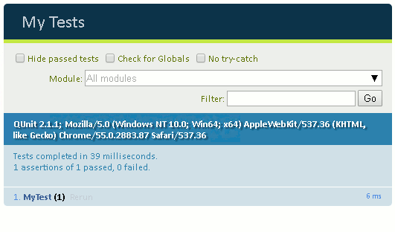
Qunit format:

Slide 11
Any Questions
?

Slide 12
Thank you

